Slide 1
IBM Data Science Capstone
Battle of the Neighborhood: Singapore

Slide 2
Objective
To analyze the neighborhood of MRT stations along Singapore’s Downtown Line and provide recommendation for visitors who travel to Singapore.

Slide 3
Business Problem
Singapore is an island nation with most number of visitors at any given time.
Singapore already has a lot websites in place to recommend places to visit or stay. But the cons are
All these available websites focus mostly on usual tourist attractions
Backpackers who usually will travel with economical budget may not be interested in those websites
The purpose of this project is to,
Choose one of the recently opened MRT lines in Singapore, Downtown line (DT) which has access to Singapore island wide
Analyze the most common venues located along the MRT line so that visitors can choose a place to stay near any DT MRT station based on their requirement.

Slide 4
Business Problem (contd..)
The project also intends to cluster the MRT stations based on the venues so that the visitors can choose to spend more time on the stations with venues of their interest.

Slide 5
Data Acquisition
MRT station names and associated details are retrieved from the open data source in Wikipedia page on all the MRT line in Singapore.
https://en.wikipedia.org/wiki/List_of_Singapore_MRT_stations
For the purpose of this project, only the alpha numeric code and respective station names in English has been chosen.
For the MRT stations of interest, location data has been retrieved using geopy package.
The top venues recommendations are retrieved from Foursquare API. FourSquare API is used to explore neighborhoods in selected towns in DT Line, Singapore.

Slide 6
Methodology
Data pre-processing
Geopy package
Foursquare API & explore option
Data Visualization
Onehot Encoding
Kmeans Clustering

Slide 7
Results / Discussion
Venues near Cashew MRT station:
Initial analysis of venues around Cashew MRT station showed most frequently occurring categories are bus station, cafes, seafood & Italian restaurants.
Below are results of number of restaurants from different cuisines along the downtown line
The number of Indian restaurants in downtown line are 50
The number of Seafood restaurants in downtown line are 21
The number of Chinese restaurants in downtown line are 63
The number of Italian restaurants in downtown line are 20

Slide 8
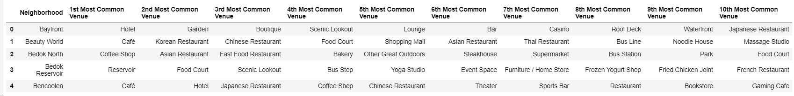
Results / Discussion (contd..)
Based on onehot encoding, each MRT station was analyzed for most common venues

Slide 9
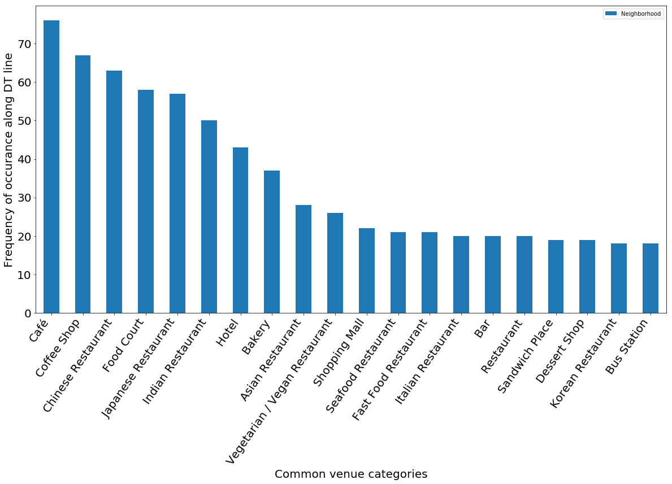
Results / Discussion (contd..)
Visualization of top 20 common venues along DT line

Slide 10
Results / Discussion (contd..)
KMeans Clustering
The results using KMeans clustering showed most stations fell under cluster 0 due to the availability of restaurants with multiple cuisines & cafes as a similarity between them.
Visitors who would like to explore multiple international cuisines like American, Japanese, Korean, Italian etc. during their visit should choose to stay near any of the MRT stations in cluster 0
Visitors like backpackers who prefer food joints with economic rates can choose cluster 1 which has food courts as the most common venue. Food courts in Singapore always come with cheaper food options
Visitors who would like to explore nature & trails are advised to choose cluster 3 which is near Bedok reservoir
Visitors who prefer vegan restaurants or Indian cuisine are better to stay at ‘Little India’ MRT station which is in cluster 4.

Slide 11
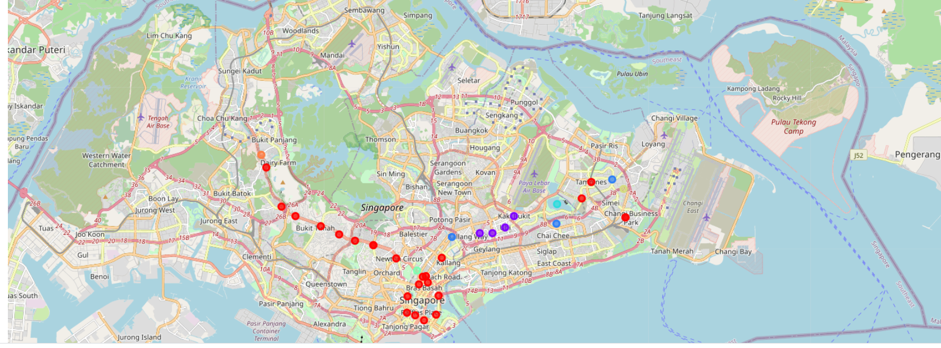
Conclusion
The clustering has shown the similarities between neighborhoods along downtown MRT line in Singapore & will be helpful for visitors who would like to stay along downtown line which has access to Singapore Island wide.

